Slide 1


Analysis of Uber’s Ride Data
Using IBM SPSS Modeler
Presented by:
Anurag Mahato
Priyanka Chadra
Page
01

Slide 2

Introduction
With the rise of app-based cab services like Uber, analyzing customer behavior and predicting booking trends have become essential for improving service efficiency.
This project uses Logistic Regression and Clustering (K-Means & Kohonen) techniques to study Uber ride data and uncover patterns in booking outcomes and customer behavior.
The goal is to predict booking cancellations and segment customers based on ride characteristics such as distance, fare, and vehicle type.
IBM SPSS Modeler was used for its visual interface and strong analytical capabilities, enabling easy model design and interpretation.
The insights from these models can help Uber reduce cancellations, optimize driver allocation, and create targeted marketing strategies.
Page
02

Slide 3
About the Dataset
The dataset used in this project is based on Uber’s 2024 ride analytics data, capturing detailed information about ride bookings throughout the year.
It contains about 1.5 lakh ride records, covering a wide range of vehicle types such as Go Mini, Go Sedan, Auto, eBike/Bike, UberXL, and Premier Sedan.
Each record represents a single booking and includes operational, behavioral, and financial attributes (Trip Duration, Booking Status, Booking Value, etc.) related to both customers and drivers.
Overall, the dataset is comprehensive, consistent, and balanced, with minimal missing values and well-defined categories — making it suitable for both predictive modeling and customer segmentation analysis.
Page
03

Slide 4
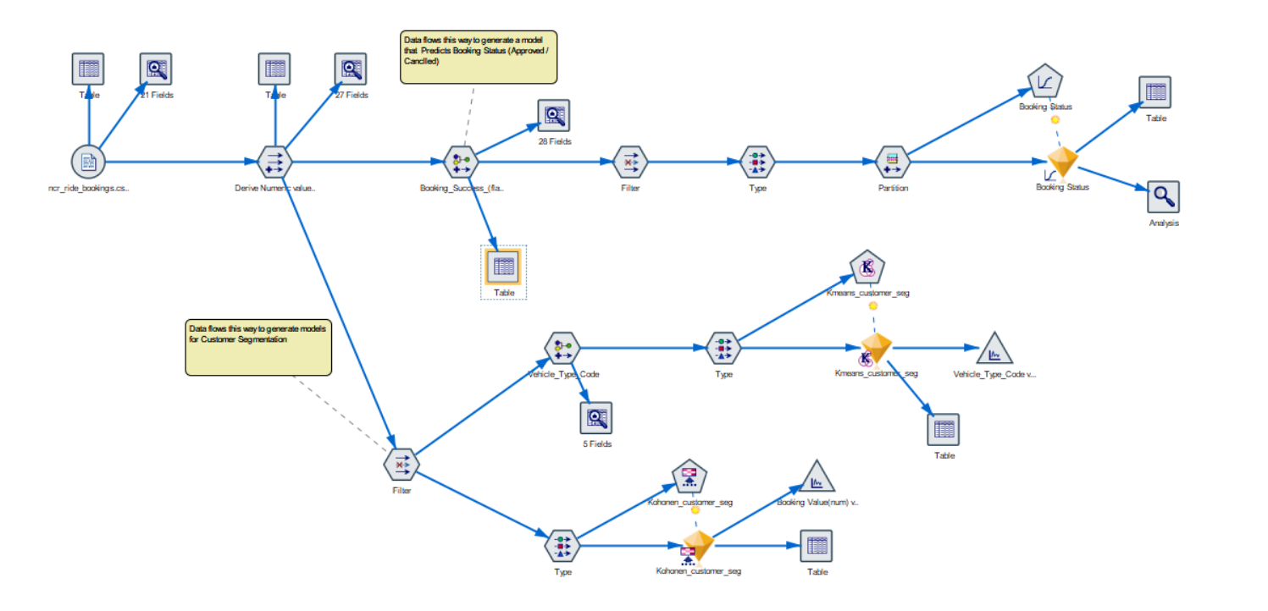
Modeling Workflow
Page
04

Slide 5
Models
Classification
Clustering
Logistic Regression Model
K-Means Model
Kohonen Model
Predicts the booking status - whether a ride will be completed or cancelled.
Accuracy : 96.59%
Performs customer segmentation by grouping similar rides or customers.
Silhouette : 0.5
Another clustering technique used for customer segmentation.
Silhouette : 0.5
Page
05

Slide 6
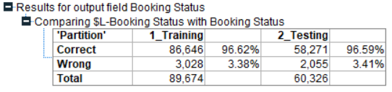
Booking Status Prediction
💜 Logistic Regression Model :
Predicts the status of a ride — whether it’s Completed, Cancelled by Customer, Cancelled by Driver, or Driver Not Found.
Uses Logistic Regression, suitable for categorical prediction with multiple outcomes.
Input fields include ride distance, booking value, and vehicle type.
Instead of using a simple 0/1 cancellation flag, the actual ‘Booking Status’ field was chosen as the target — ensuring the company knows why a booking was cancelled, not just whether it was.
Applications :
Identify key reasons for ride cancellations.
Improve driver availability and customer satisfaction.
Enable data-driven decision-making for service optimization.
Page
06

Slide 7
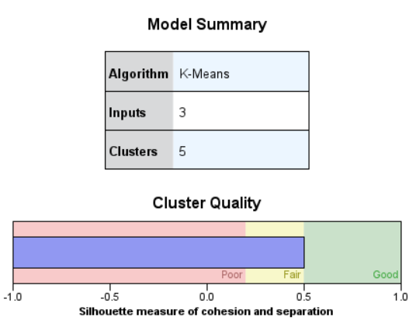
Customer Segmentation
💜 K-Means Clustering Model :
Groups customers based on vehicle type, ride distance, and booking value.
Uses K-Means Clustering with a Silhouette score of 0.5.
Each customer assigned to the nearest cluster based on similarity.
Applications :
Identify frequent or high-value customers.
Support targeted marketing and offers.
Enhance personalization and service strategies.
Page
07

Slide 8
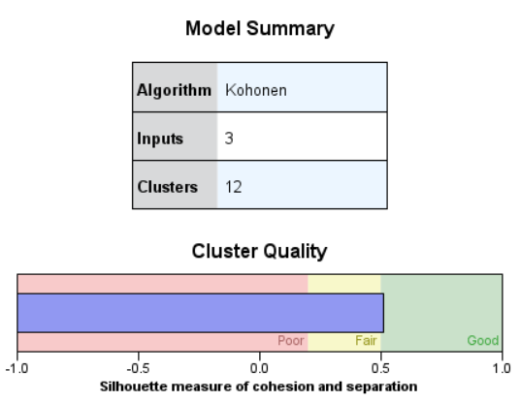
💜 Kohonen Model :
Uses Kohonen Self-Organizing Map (SOM) with a Silhouette score of 0.5.
Visualizes complex data into a 2D grid for easy interpretation.
Input fields: ride frequency, distance, and booking value.
Applications :
Discover natural relationships among customers.
Provide visual insights into customer behavior.
Validate and complement K-Means clustering results.
Page
08

Slide 9




Thank
You.
Get In Touch With Us
Page
09

